Slide 1
Chapter 8
Everyday Memory and Memory Errors
Notes:
Hello Everyone, welcome back! In the last couple of videos, we’ve been discussing memory and have largely been assuming that everything works great. However, as you all are well aware, human memory isn’t perfect. For this chapter, we’re going to continue our discussions of memory – We’ll start out talking about autobiographical memory and will end discussing some potential memory pitfalls.

Slide 2
Autobiographical Memory (AM)
  Memory for specific experiences from our life, which can include both episodic and semantic components
  Mental time travel
  Multidimensional
  Spatial, emotional, and sensory components
Notes:
Semantic in that you remember specific facts, episodic in that you are reliving experiences. Often sensory experiences!

Slide 3
Autobiographical Memory (1 of 3)
  Sensory component
  Greenberg and Rubin (2003)
  Patients who cannot recognize objects also experience loss of autobiographical memory
  Visual experience plays a role in forming and retrieving AM

Slide 4
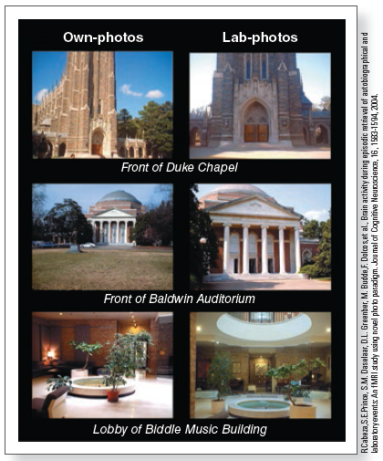
Autobiographical Memory (2 of 3)
  Cabeza et al. (2004)
  Comparing brain activation caused by autobiographical memory and lab memory
  Participants viewed
    Photographs they took (own-photos)
    Photographs taken by someone else (lab-photos)
Notes:
(Source: Cabeza eFigure 8.1 Photographs from Cabeza and coworkers’ (2004) experiment. Own-photos were taken by the participant; lab-photos were taken by someone else.
t al., 2004)

Slide 5
Autobiographical Memory (3 of 3)
  Both types of photos activated similar brain structures
  Medial temporal lobe (MTL) (episodic)
  Parietal cortex (processing of scenes)
  Own-photos activated more of the
  Prefrontal cortex (information about self)
  Hippocampus (recollection)
  Demonstrates the richness of autobiographical memories

Slide 6
Memory Over the Lifespan
What events are remembered well?
  Significant events in a person’s life
  Highly emotional events
  Transition points

Slide 7
Reminiscence Bump (1 of 5)
Participants over age 40 asked to recall events in their lives
Memory is high for recent events and for events that occurred in adolescence and early adulthood (between 10 and 30 years of age)

Slide 8
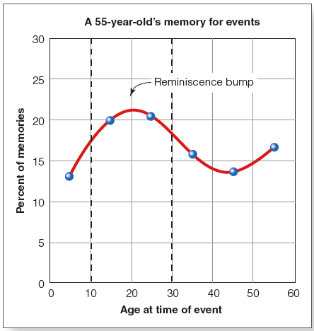
Reminiscence Bump (2 of 5)
Notes:
Figure 8.3 Percentage of memories from different ages recalled by a 55-year-old, showing the reminiscence bump, which occurs for events experienced between about 10 and 30 years of age (dashed lines).

Slide 9
Explanations for the Reminiscence Bump
EXPLANATION | BASIC CHARACTERISTIC
Self-image | Period of assuming person's self-image.
Cognitive | Encoding is better during periods of rapid change.
Cultural life script | Culturally shared expectations structure recall.

Slide 10
Reminiscence Bump (3 of 5)
Self-image hypothesis
  Memory is enhanced for events that occur as a person’s self-image or life identity is being formed
  People assume identities during adolescence and young adulthood
    Many transitions occur between ages 10 and 30
Cognitive hypothesis
  Encoding is better during periods of rapid change that are followed by stability
  Evidence from those who emigrated to the United States after young adulthood indicates reminiscence bump is shifted

Slide 11
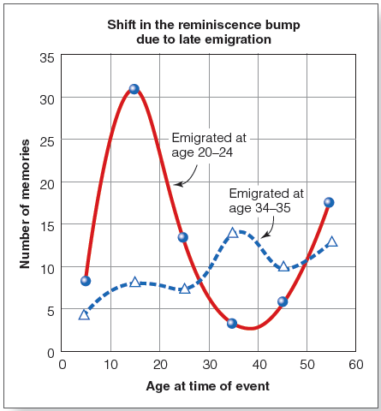
Reminiscence Bump (4 of 5)
Notes:
(Source: R. W. Schrauf & D. C. Rubin, Bilingual autobiographical memory in older adult immigrants: A test of cognitive explanations of the reminiscence bump and the linguistic encoding of memories, Journal of Memory and Language, 39, 437–457. Copyright © 1998 Elsevier Ltd. Republished with permission.)

Slide 12
Reminiscence Bump (5 of 5)
Cultural life script hypothesis
Each person has
  a personal life story
  an understanding of culturally expected events
Personal events are easier to recall when they fit the cultural life script

Slide 13
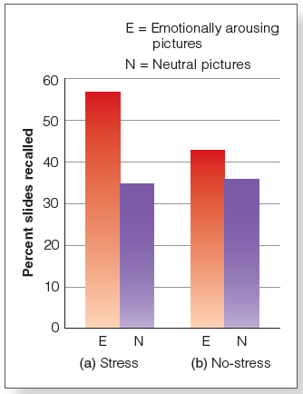
Memory for “Exceptional” Stimuli
Emotional events: more easily and vividly remembered
Emotion improves memory, becomes greater with time (may enhance consolidation)
Tendency to attend to a weapon during a crime
Notes:
Figure 8.7 (a) Recall for emotional pictures is better than for neutral pictures when subjects are exposed to stress. (b) There is no significant difference between emotional and neutral recall in the no-stress condition. This result has been related to enhanced memory consolidation for the emotional pictures.

Slide 14

Flashbulb Memories (1 of 5)
Memory for the circumstances surrounding shocking, highly charged important events
  9/11 terror attacks
  Kennedy assassination
  Challenger explosion
Where you were, and what you were doing
Highly emotional, vivid, and very detailed

Slide 15
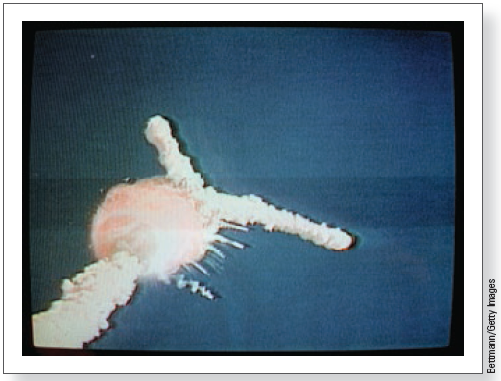
Flashbulb Memories (2 of 5)
Flashbulb memories are not “photograph” memories
They can change with the passage of time
Notes:
Figure 8.8 Neisser and Harsch (1992) studied people’s memories for the day they heard about the explosion of the space shuttle Challenger.

Slide 16
Flashbulb Memories (3 of 5)
Neisser and Harsch (1992); Talarico and Rubin (2003)
Repeated recall
  Initial description: baseline
  Later reports compared to baseline
Results suggest that these memories can be inaccurate or lacking in detail
  Even though participants claim confidence and that memories seem very vivid

Slide 17
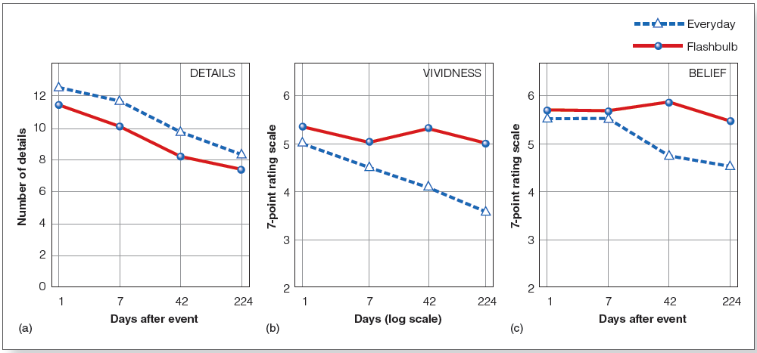
Flashbulb Memories (4 of 5)
Notes:
Figure 8.9 Results of Talarico and Rubin’s (2003) flashbulb memory experiment: (a) details remembered; (b) vividness ratings; and (c) belief in accuracy. Details remembered decreased for both flashbulb and everyday memories. Belief in accuracy and vividness also decreased for everyday memories but remained high for flashbulb memories.

Slide 18
Flashbulb Memories (5 of 5)
Narrative rehearsal hypothesis
  Repeated viewing/hearing of event
    TV, newspaper, radio, talking with others
    Could introduce errors in own memory

Slide 19
The Constructive Nature of Memory (1 of 2)
Memory = what actually happens + person’s knowledge, experiences, and expectations

Slide 20
The Constructive Nature of Memory (2 of 2)
Bartlett’s “war of the ghosts” experiment
  Had participants attempt to remember a story from a different culture
  Repeated reproduction
Results
  Over time, reproduction became shorter, contained omissions and inaccuracies
  Changed to make the story more consistent with their own culture

Slide 21
Source Monitoring (1 of 3)
Source memory: process of determining origins of our memories
Source monitoring error: misidentifying source of memory
  Also called “source misattributions”
Cryptomnesia: unconscious plagiarism of another’s work due to a lack of recognition of its original source

Slide 22
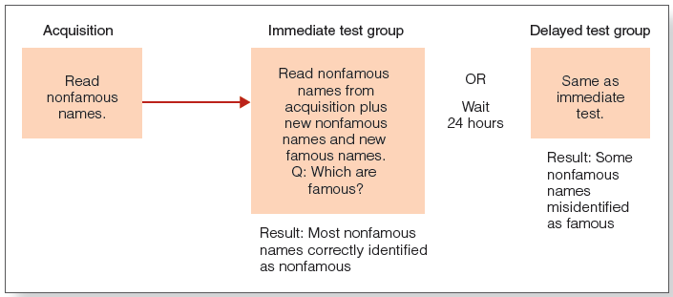
Source Monitoring (2 of 3)
Jacoby et al. (1989)
Notes:
Figure 8.10 Design of Jacoby et al.’s (1989) “Becoming Famous Overnight” experiment.

Slide 23
Source Monitoring (3 of 3)
After 24 hours, some nonfamous names were misidentified as famous
Explanation: some nonfamous names were familiar, and the participants misattributed the source of the familiarity
  Failed to identify the source as the list that had been read the previous day

Slide 24
The Illusory Truth Effect
Enhanced probability of evaluating a statement is true after repeated presentation
Occurs due to fluency or familiarity with the information
Related to the propaganda effect
  Both result from stimulus repetition

Slide 25
Making Inferences
Memory can be influenced by inferences that people make based on their experiences and knowledge
Pragmatic inferences: based on knowledge gained through experience
  Memory often includes information that is implied by or is consistent with the to be remembered information but was not explicitly stated

Slide 26
Schemas and Scripts (1 of 2)
Schema: knowledge about some aspect of the environment
  e.g., Post office, ball game, classroom
Script: conception of sequence of actions that usually occurs during a particular experience
  Going to a restaurant; playing tennis

Slide 27
Schemas and Scripts (2 of 2)
Schemas and scripts influence memory
  Memory can include information not actually experienced but inferred because it is expected and consistent with the schema
  Office waiting room: books not present but mentioned in memory task
  The constructive nature of memory can lead to errors or “false memories”

Slide 28
Construction of Memories (1 of 2)
Advantages
  Allows us to “fill in the blanks”
  Cognition is creative
    Understand language
    Solve problems
    Make decisions

Slide 29
Construction of Memories (2 of 2)
Disadvantages
  Sometimes we make errors
  Sometimes we misattribute the source of information
    Was it actually presented or did we infer it?

Slide 30
Power of Suggestion (1 of 5)
The misinformation effect: misleading information presented after someone witnesses an event can change how that person later describes the event
  Misleading postevent information (MPI)

Slide 31
Power of Suggestion (2 of 5)
Loftus et al. (1975)
  See slides of traffic accident with stop sign
  Introduce MPI: yield sign
  Participants remember what they heard (yield sign) and not what they saw (stop sign)
Loftus and Palmer (1974)
  Hear “smashed” or “hit” in description of car accident
  Those hearing “smashed” said the cars were going much faster than those who heard “hit”

Slide 32
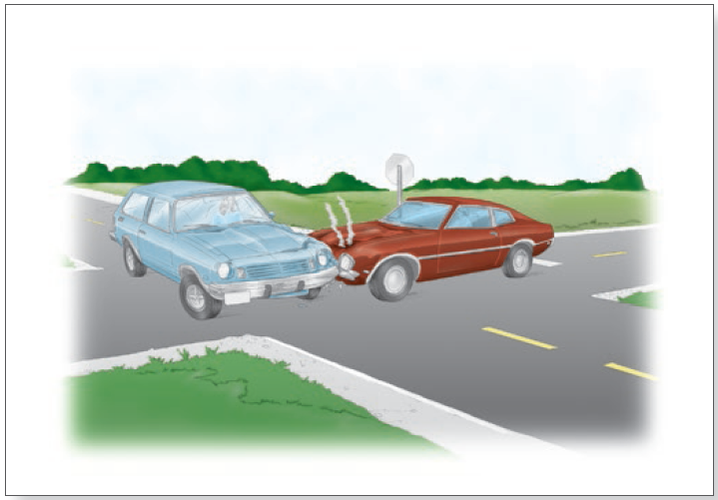
Power of Suggestion (3 of 5)
Notes:
Figure 8.12 Participants in the Loftus and Palmer (1974) experiment saw a film of a car crash, with scenes similar to the picture shown here, and were then asked leading questions about the crash.

Slide 33
Power of Suggestion (4 of 5)
Source monitoring error
  Failure to distinguish the source of the information
  MPI is misattributed to the original source
Lindsay (1990)
  Heard a story; 2 days later again with some details changed
  Told to ignore changes
  Same voice for both stories created source monitoring errors
  Changing voice (male to female) did not create as many errors

Slide 34
Power of Suggestion (4 of 5)
Source monitoring error
  Failure to distinguish the source of the information
  MPI is misattributed to the original source

Slide 35
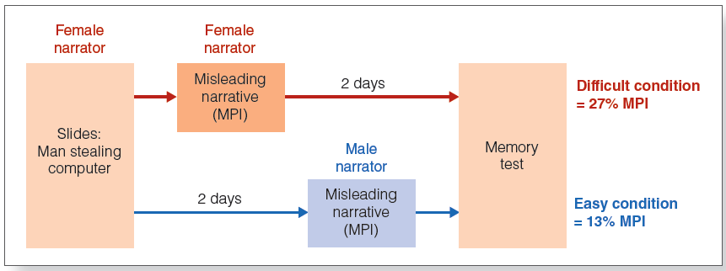
Power of Suggestion (5 of 5)
Lindsey (1990)
Notes:
Lindsay (1990)
Heard a story; 2 days later again with some details changed
Told to ignore changes
Same voice for both stories created source monitoring errors
Changing voice (male to female) did not create as many errors

Slide 36
False Memories
Hyman and coworkers (1995)
  Participants’ parents gave descriptions of childhood experiences
  Participant had conversation about experiences with experimenter; experimenter added new events
  When discussing it later, participant “remembered” the new events as actually happening

Slide 37
Errors in Eyewitness Testimony (1 of 8)
Testimony by an eyewitness to a crime about what he or she saw during the crime
One of the most convincing types of evidence to a jury
  Assume that people see and remember accurately
Like other memory, eyewitness testimony can be inaccurate
  Mistaken identity
  Constructive nature of memory

Slide 38
Errors in Eyewitness Testimony (2 of 8)
Wells and Bradfield (1998)
  Participants view security videotape with gunman in view for 8 seconds
  Everyone identified someone as the gunman from photographs afterward
  The actual gunman’s picture was not presented

Slide 39
Errors in Eyewitness Testimony (3 of 8)
Errors due to attention and arousal
  Attention can be narrowed by specific stimuli
  Weapons focus
  Stanny and Johnson (2000)

Slide 40
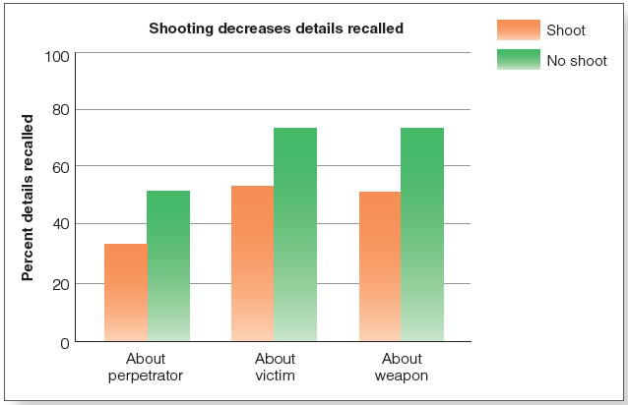
Errors in Eyewitness Testimony (4 of 8)
Notes:
Figure 8.15 Results of Stanny and Johnson’s (2000) weapons focus experiment. Presence of a weapon that was fired is associated with a decrease in memory about the perpetrator, the victim, and the weapon.

Slide 41
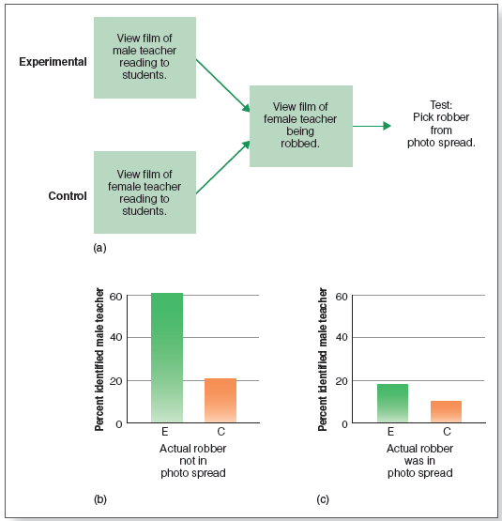
Errors in Eyewitness Testimony (5 of 8)
Errors due to familiarity
  Source monitoring
Notes:
Figure 8.16 (a) Design of Ross et al.’s (1994) experiment on the effect of familiarity on eyewitness testimony. (b) When the actual robber was not in the photo spread, subjects in the experimental group erroneously identified the male teacher as the robber 60 percent of the time. (c) When the actual robber was in the photo spread, the male teacher was identified 18 percent of the time.

Slide 42
Errors in Eyewitness Testimony (6 of 8)
Errors due to suggestion
  Suggestive questioning
    The misinformation effect
  Confirming feedback
    Post-identification feedback effect

Slide 43
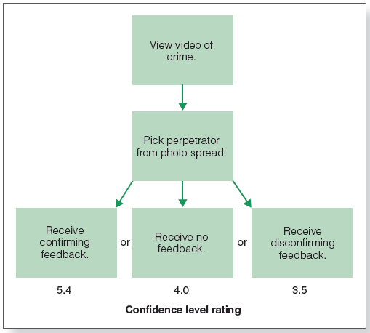
Errors in Eyewitness Testimony (7 of 8)
Notes:
Figure 8.17 Design and results of Wells and Bradfield’s (1998) “Good, You Identified the Suspect” experiment. The type of feedback from the experimenter influenced subjects’ confidence in their identification, with confirming feedback resulting in the highest confidence.

Slide 44
Errors in Eyewitness Testimony (8 of 8)
Confidence in one’s memories may be increased by postevent questioning
May make memories easier to retrieve

Slide 45
Strategies to Improve Eyewitness Testimony
Inform witness that perpetrator might not be in lineup
Use “fillers” in lineup similar to suspect
Use sequential presentation (not simultaneous)
Improve interviewing techniques
  Cognitive interview

